Slide 1
Advanced Algorithms for THz Sensing and Recognition
Murat Torlak and Yiorgos Makris
October 4th, 2021, Review

Slide 2
Updates
Mail Threat Detection
THz Simulator Software
Future Work

Slide 3
Mail Threat Detection

Slide 4
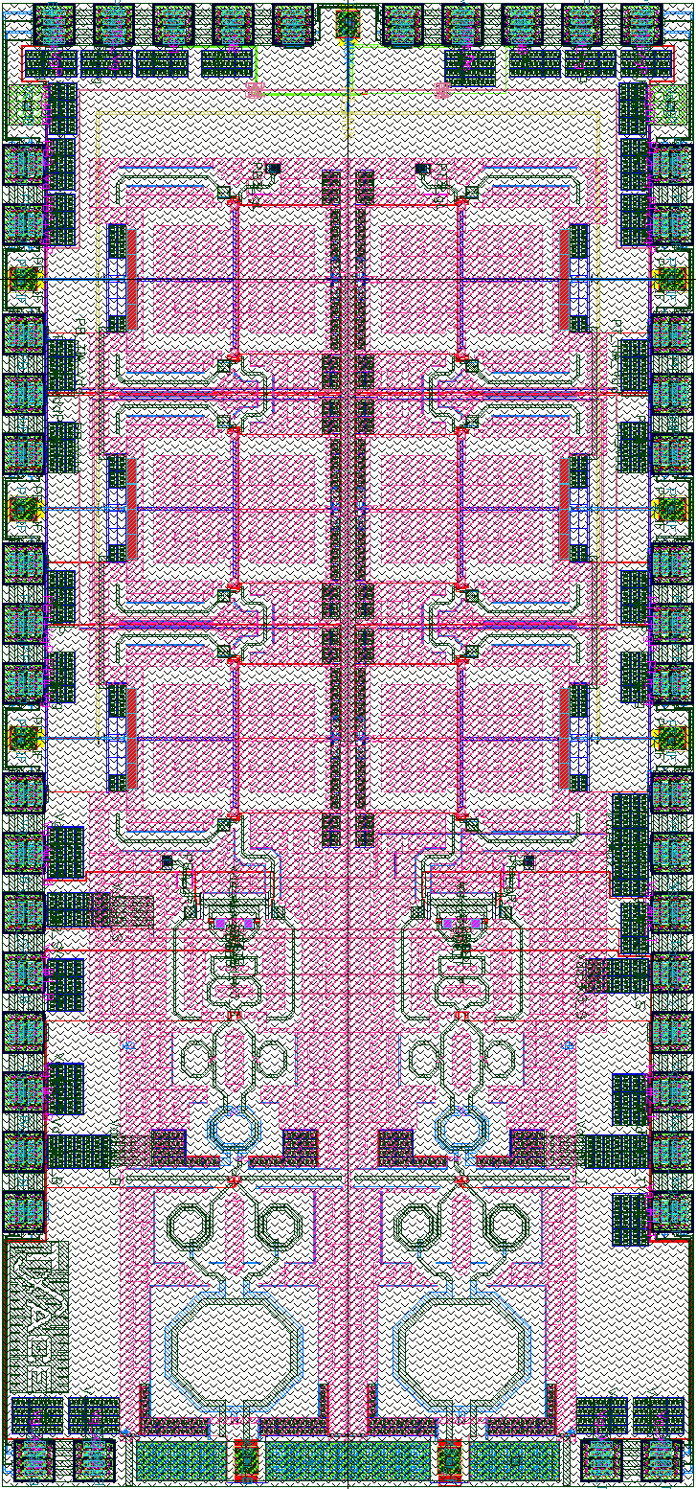

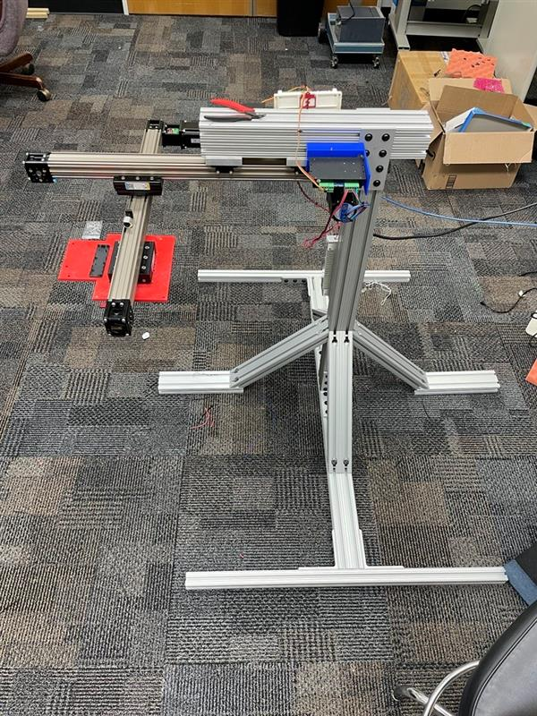
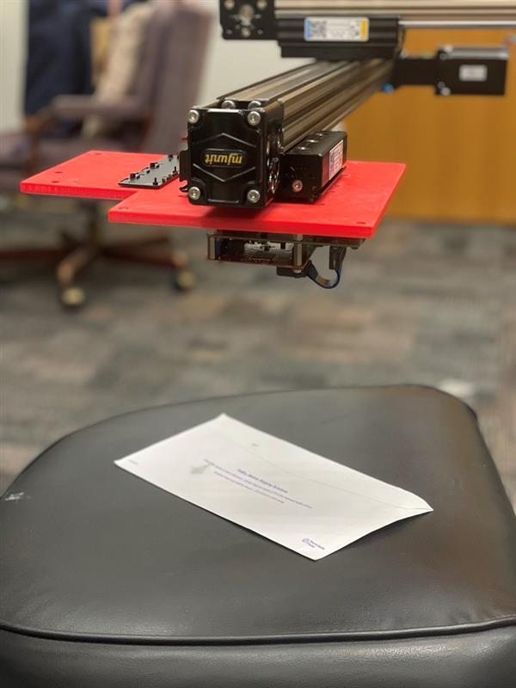

Mail Threat Detection System
Mail inspection scanner
Requires downward-facing imaging system
Built new, versatile system
TI 77GHz mmWave Radar
Resolution scales with carrier frequency
1m

Slide 5
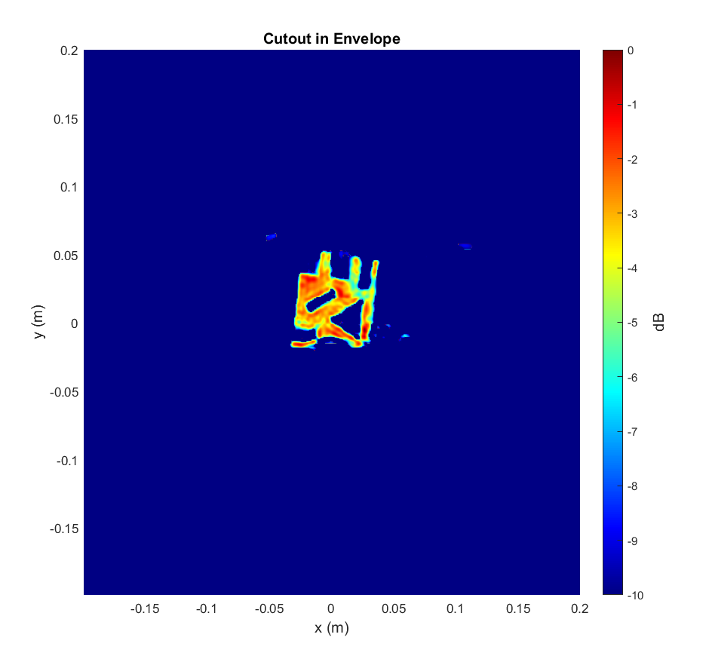
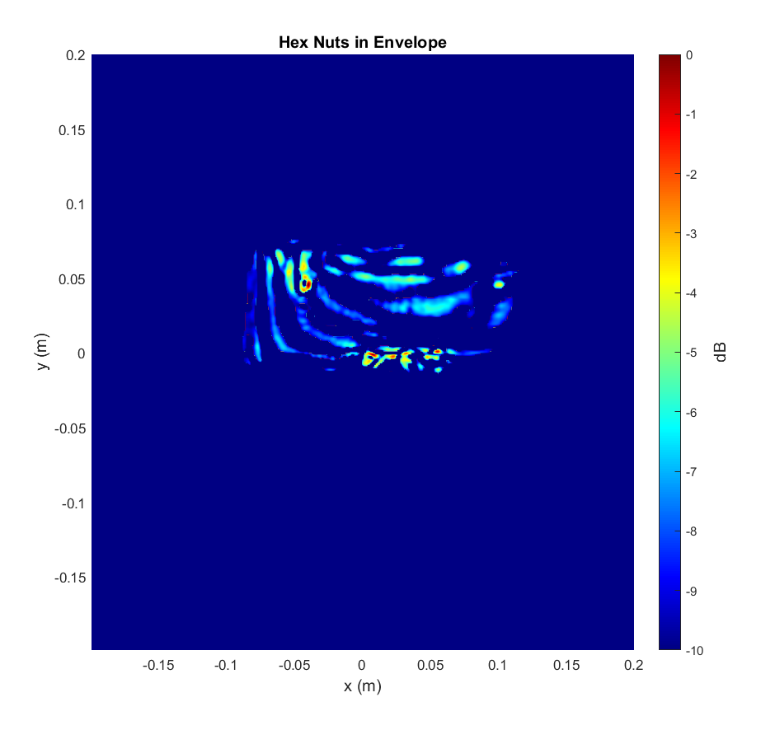
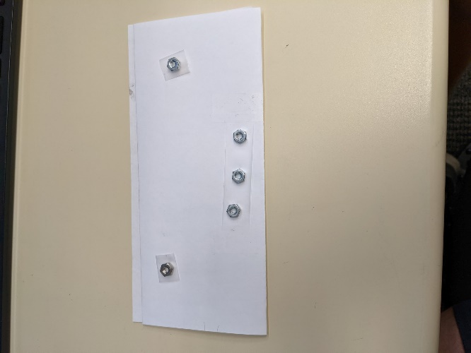

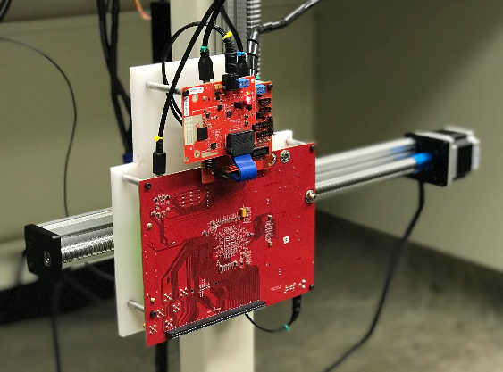
Early Results + Analysis
High Reflectivity Target
Strong reflection
Easily identifiable
Low Reflectivity Target
Weak reflection
Somewhat obscured by interferers
TI 77GHz mmWave Radar
Resolution scales with carrier frequency

Slide 6
THz Simulation Software

Slide 7
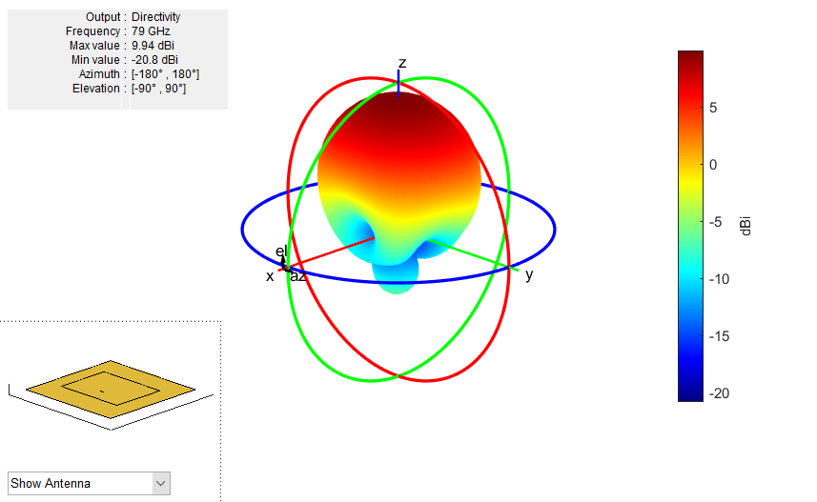
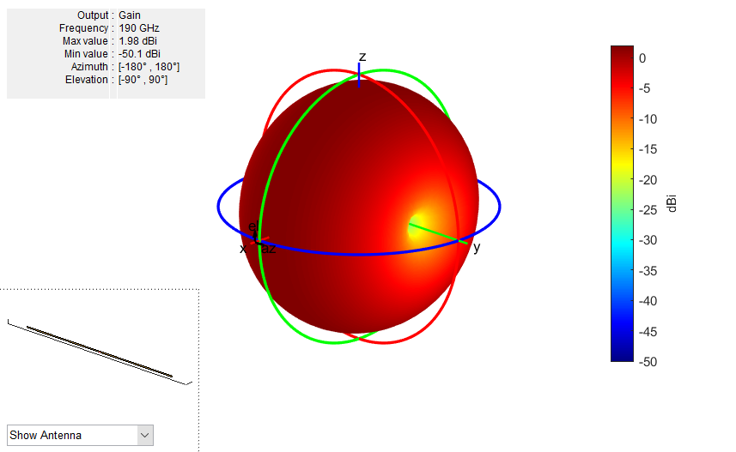
Use Any Antenna Pattern
Patch Antenna
Dipole

Slide 8
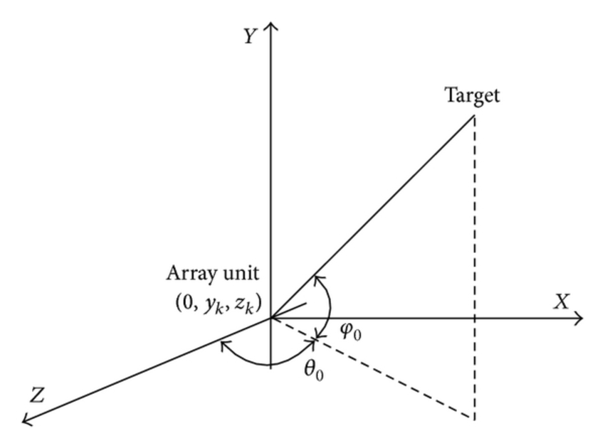
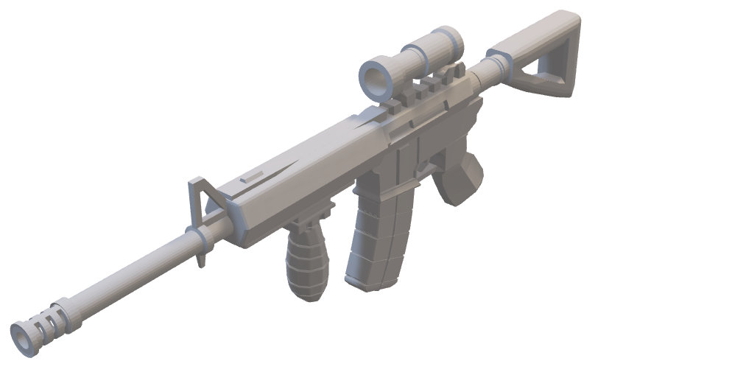
Computes All Angles Between Antennas + Target
Requires calculation of all angles between every antenna element + target voxel
Computational expensive for large targets

Slide 9
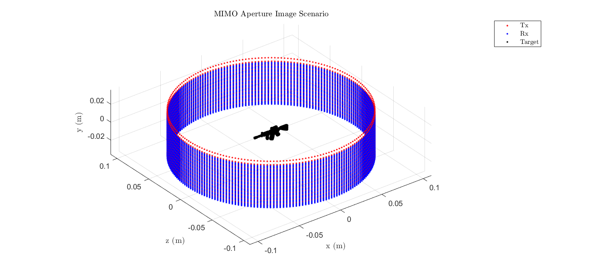
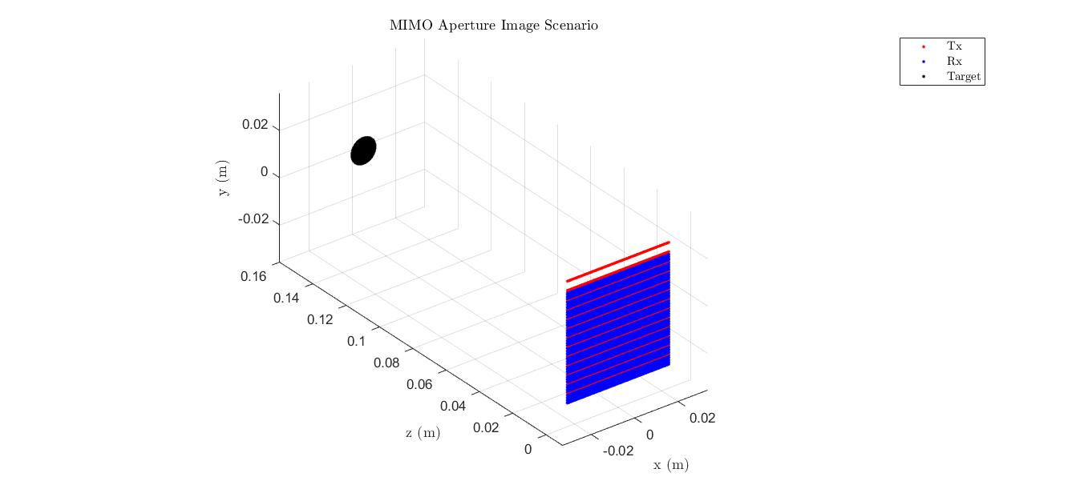
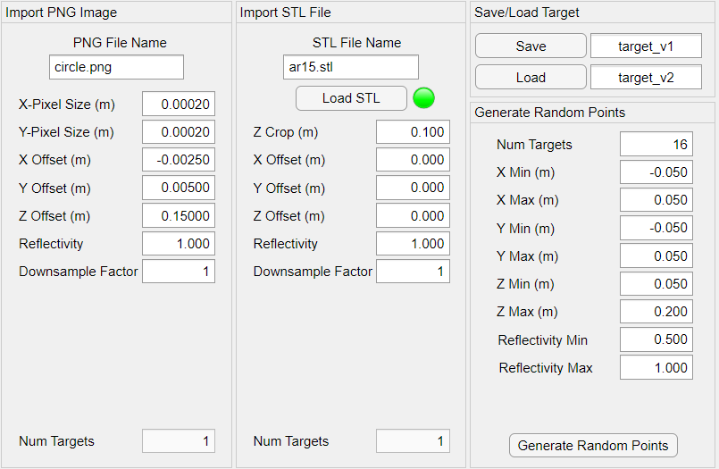
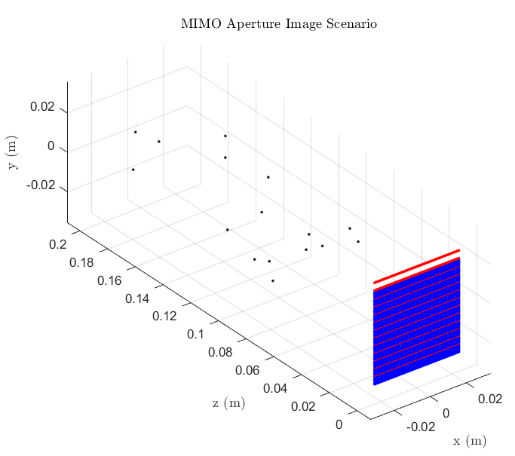
Set Up Scanning Scenario
Choose scanning type, sampling parameters
Set up SAR scan scenario
3D Gun Model
2D Flat Image
Randomly placed points

Slide 10
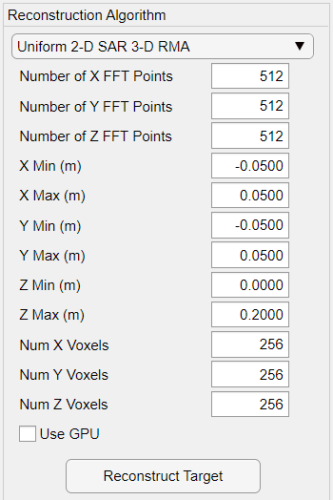
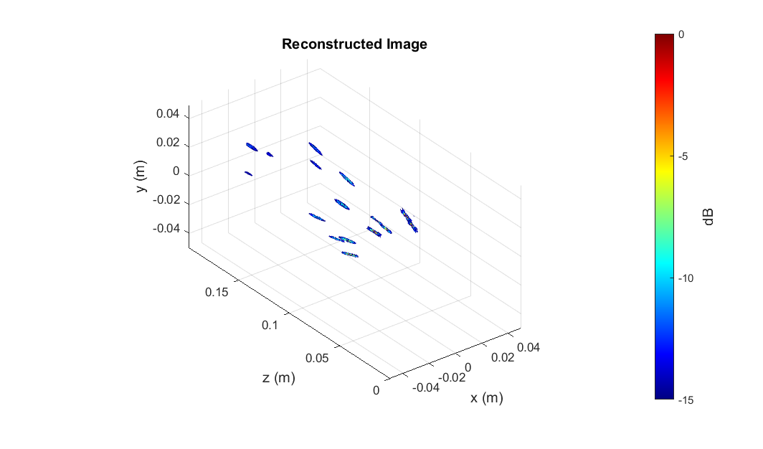
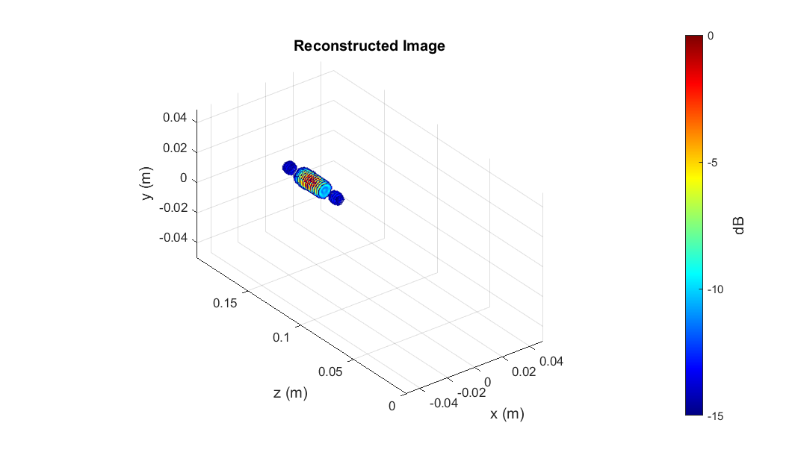
Reconstruct Image
Randomly placed points
2D Flat Image
Choose reconstruction algorithm
Prototype new algorithms

Slide 11
Future Work

Slide 12
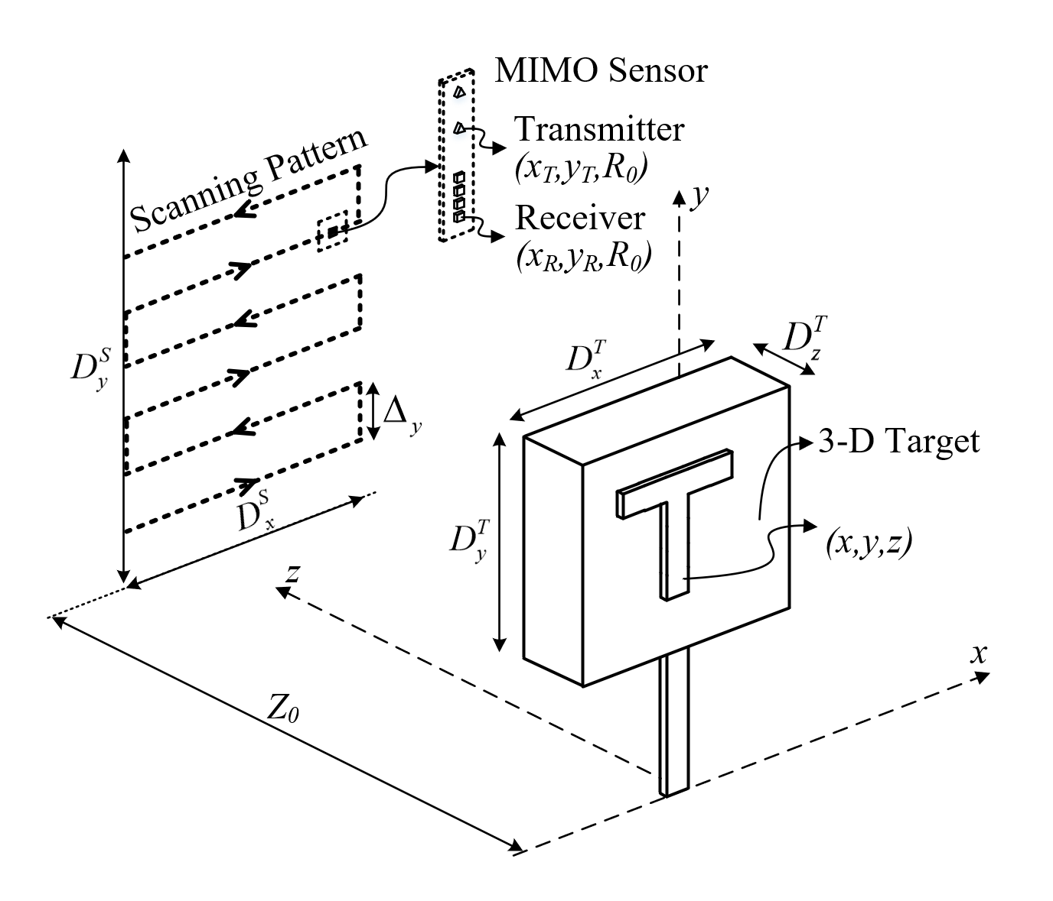
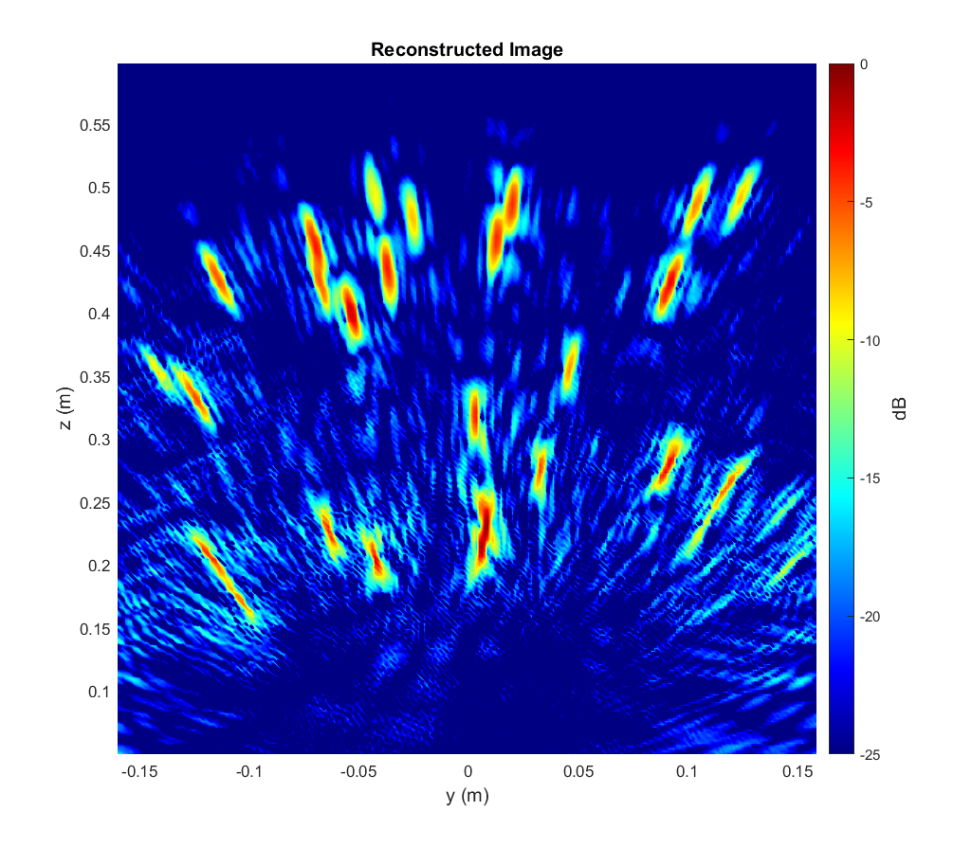
Dataset Generation
Generate “synthetic” datasets
Randomly placed points
Number of points randomly varied between samples
Both ideal and non-ideal antenna positions

Slide 13
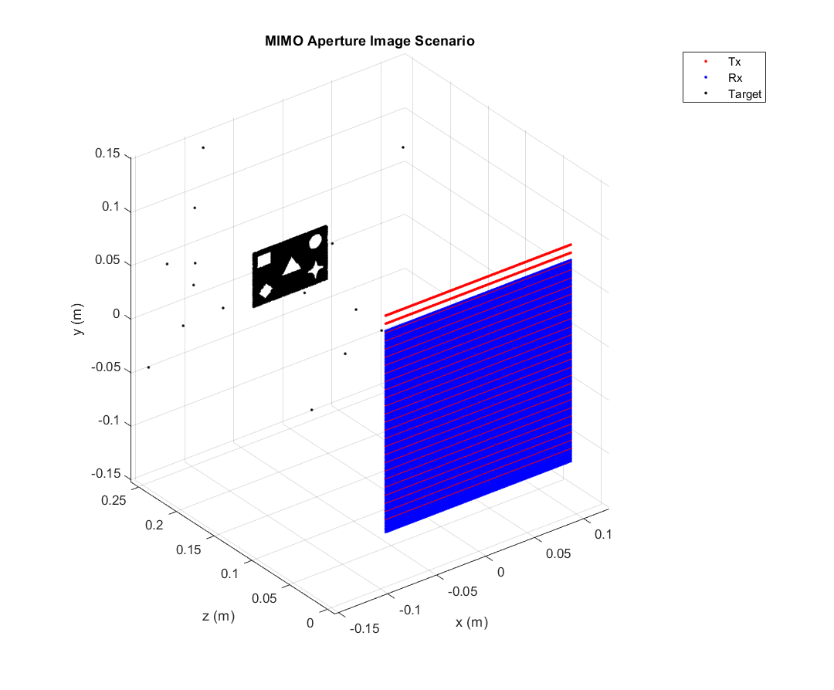
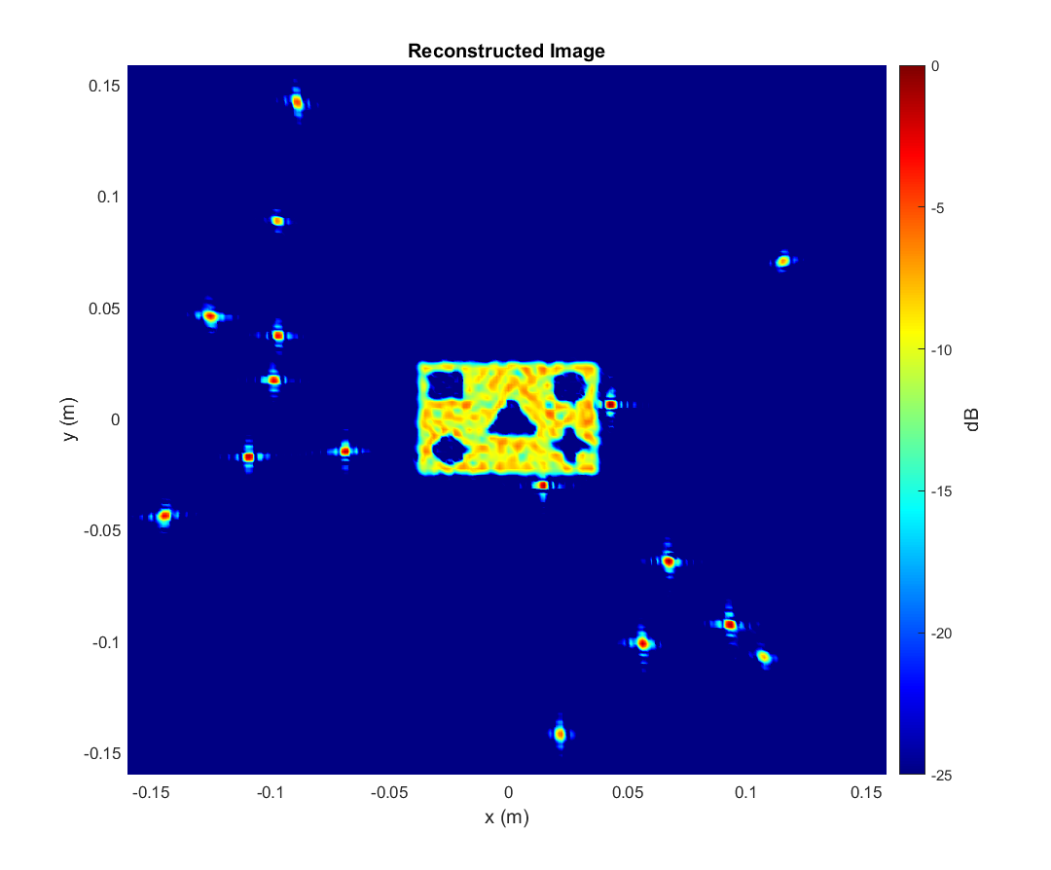
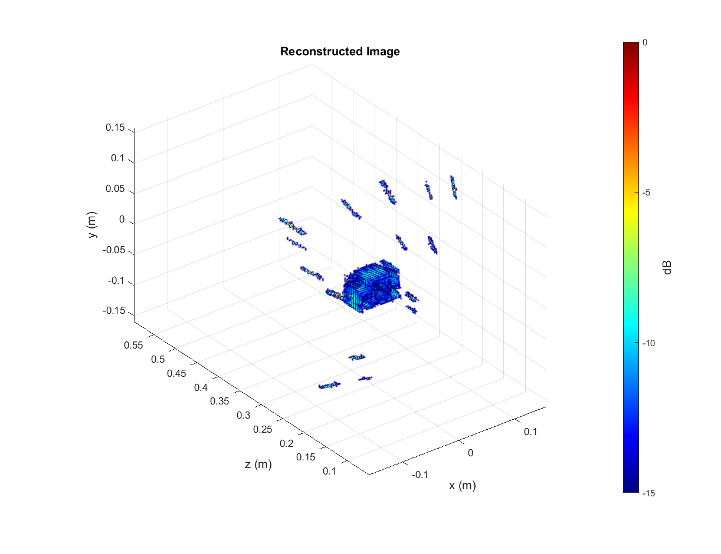
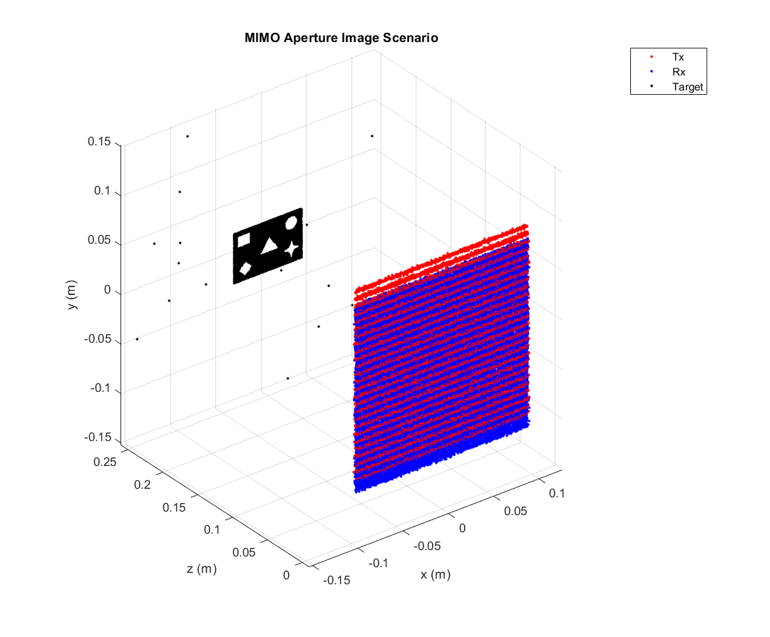
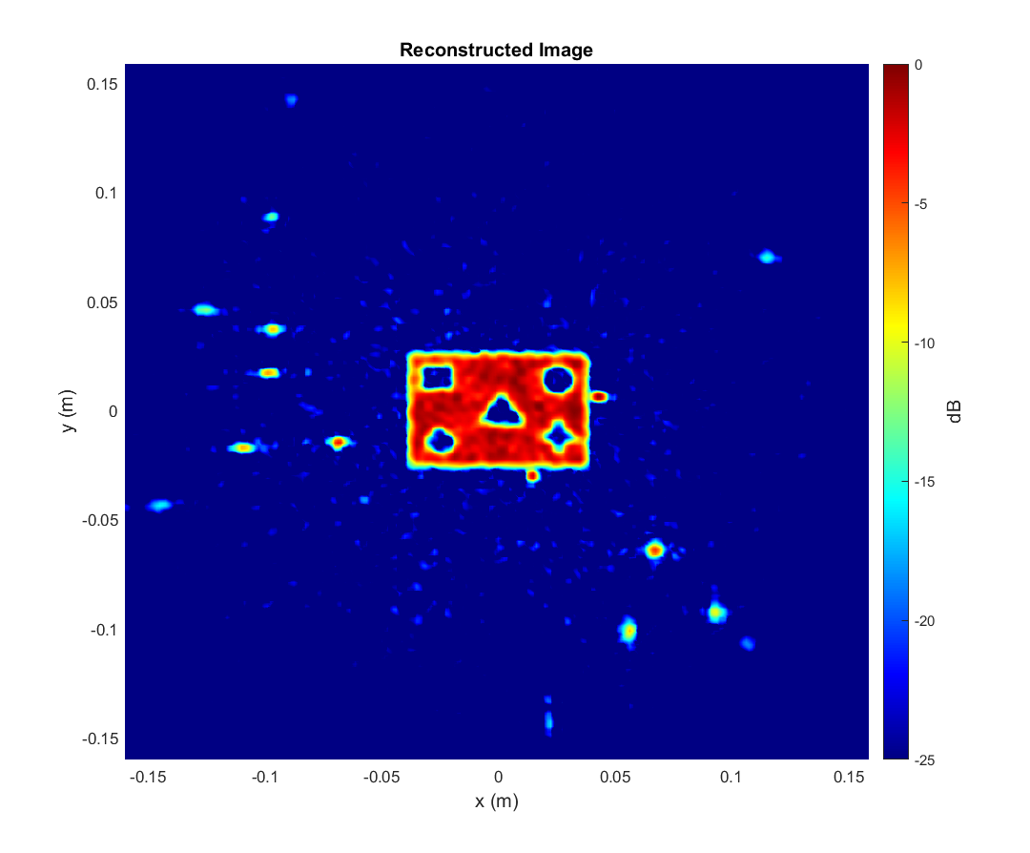
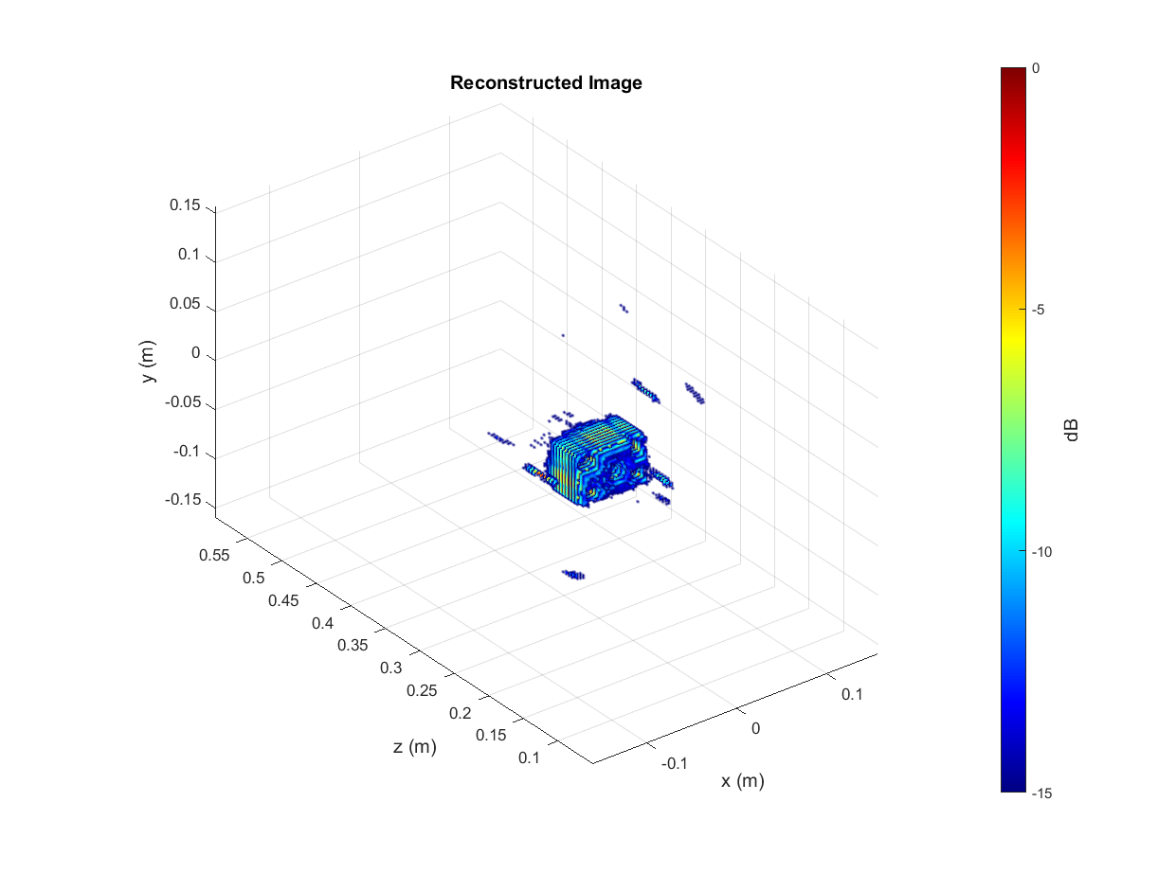
Ideal vs Antenna Position Error

Slide 14
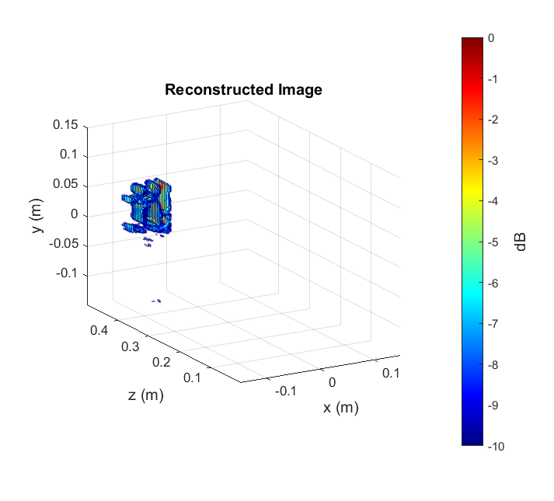
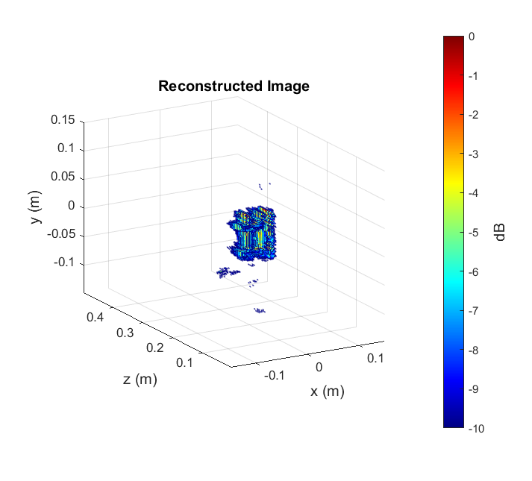
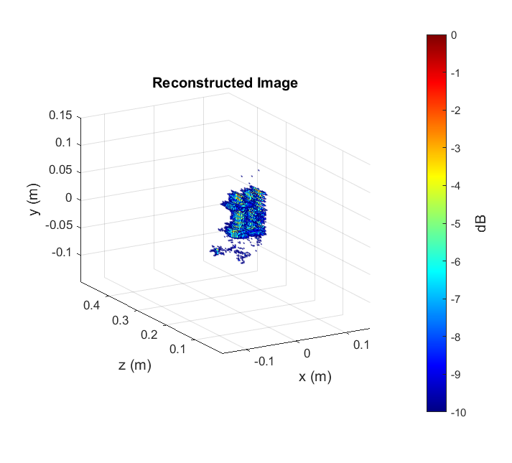
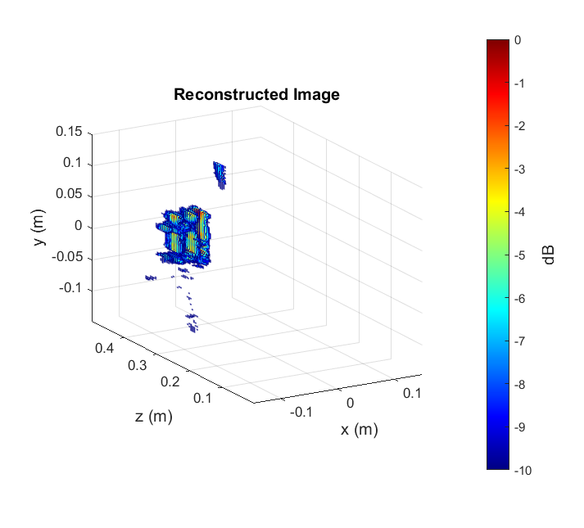
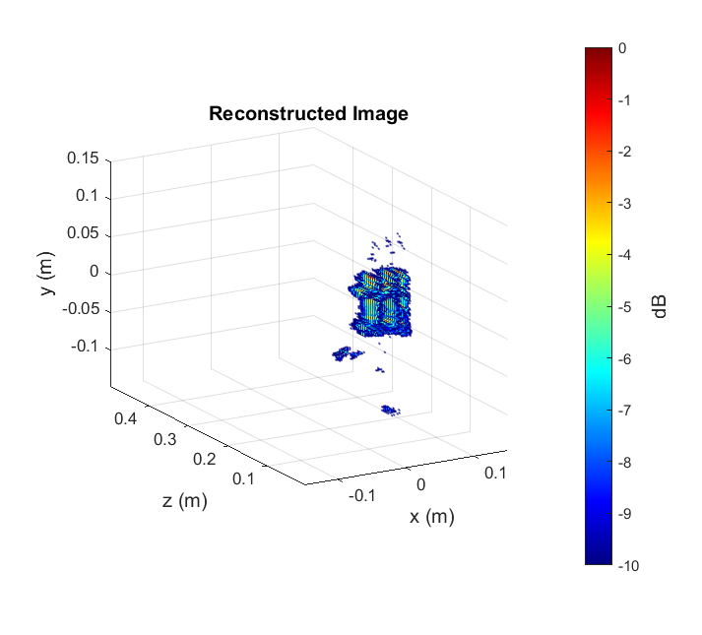
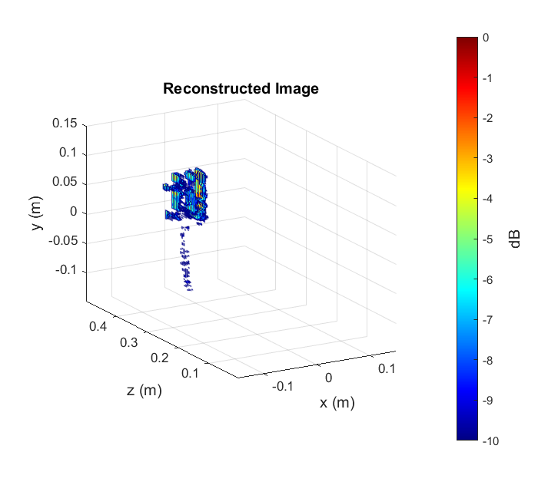
Real Image Dataset
Envelope Scenario
Can be used for either 2-D or 3-D imaging
Cutout in multiple positions
Can supplement the synthetic data to improve the training quality

Slide 15
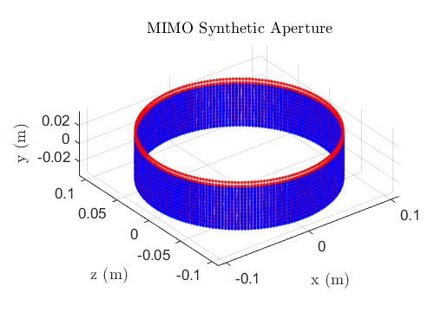
Future Work
Publish THz Simulator paper
Mail Inspection Scanner
Collect dataset with new scanner
Develop binary classifier
ML Design
Balancing signal processing techniques + ML
Assist with ML dataset pipeline + algorithm development
Unsupervised learning models
1m

